Slide 1


Registration Seminar
Deep Learning-Based Early Disease Classification System for Thoracic Radiographs
Under the Supervision of
Dr. Prabina Pattanayak and Dr. Chandrajit Chowdhury
Presented By
Kirti Swagat Mohanty
21-3-04-068
Photo by Pexels
Department of Electronics and Communication Engineering,
National Institute of Technology, Silchar

Slide 2

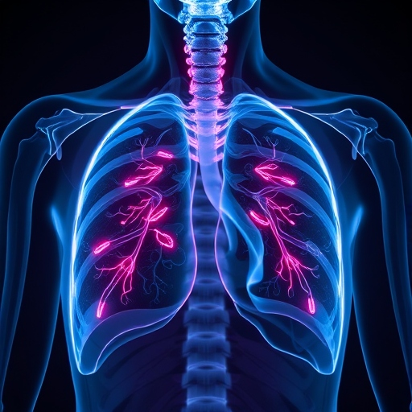
Table of Contents
1
Introduction
2
Literature Review
6
3
Motivation
7
4
Problem Statements & Methodology
8
5
References

Slide 3
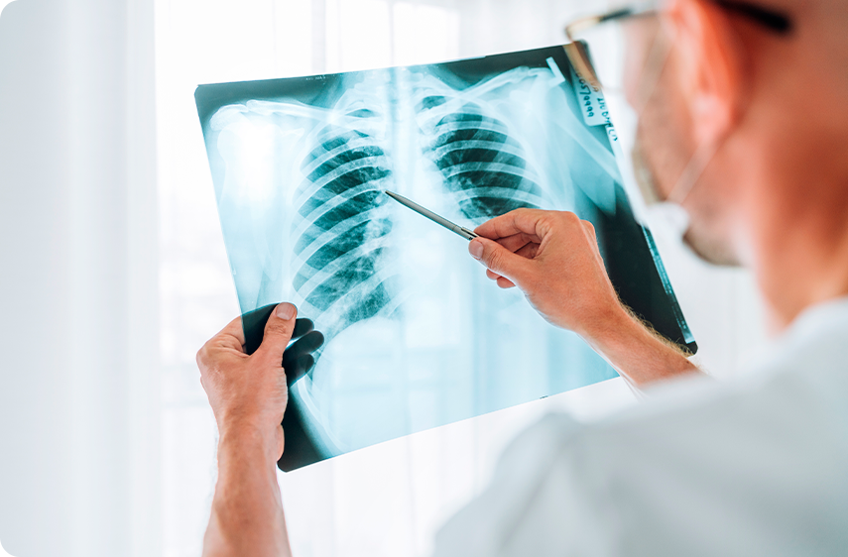
Introduction
Pulmonary diseases represent a significant global health burden, affecting millions of people worldwide and contributing substantially to morbidity and mortality rates.
Early and accurate diagnosis of these conditions is crucial for effective treatment and improved patient outcomes.
Chest X-rays are indispensable tools in understanding lung health and diagnosing pulmonary diseases, providing clear images of various lung conditions.
They are budget-friendly and easy to perform, making them widely accessible for initial evaluations in medical settings around the world.
Their ability to reveal crucial information enables early detection and monitoring of lung diseases, benefiting both patients and healthcare providers.
Despite their strengths, X-rays can be complex in interpretation, highlighting the need for enhanced diagnostic support systems.
Image Source: https://www.sleepdrs.com
Notes:
In today's healthcare landscape, pulmonary diseases stand as one of our most pressing global health challenges, affecting countless lives and placing an enormous burden on healthcare systems worldwide. The impact of these conditions extends far beyond individual patients, creating ripple effects throughout communities and healthcare infrastructures.
At the forefront of combating this challenge stands the chest X-ray - a remarkable diagnostic tool that has revolutionized our ability to understand and treat lung conditions. This time-tested technology offers an unparalleled combination of accessibility and effectiveness, making it the cornerstone of pulmonary diagnostics in healthcare settings across the globe. Its cost-effectiveness and ease of implementation have made it particularly valuable in resource-limited environments, democratizing access to essential diagnostic capabilities.
The power of chest X-rays lies in their ability to unveil critical insights into lung health, enabling healthcare providers to detect and monitor various pulmonary conditions with remarkable precision. This capability has proven instrumental in early disease detection and treatment planning, significantly improving patient outcomes. However, the interpretation of these images presents its own set of challenges, highlighting an important opportunity for advancement in diagnostic support systems.
As we explore the intersection of traditional radiographic imaging and modern diagnostic approaches, we stand at the threshold of a new era in pulmonary healthcare - one where enhanced accuracy and accessibility work hand in hand to better serve patients worldwide.

Slide 4
Literature Review
Deep Learning in Chest Radiograph
Siamese Networks and Contrastive Learning
Transfer Learning and Model Adaptation
Dataset Utilization and Model Evaluation
Multi-Task Learning in Medical Imaging

Slide 5
Literature Review
Authors, Year | Findings/ Conclusion
Rajpurkar et al., 2018 | CheXNeXt achieved radiologist-level performance on 11 pathologies. CheXNeXt performed better than radiologists in detecting atelectasis, with an AUC of 0.862 (95% CI .825–0.895), statistically significantly higher than radiologists’ AUC of 0.808 (95% CI 0.777–0.838).
Okolo et al., 2022 | Proposed and evaluated the Input Enhanced Vision Transformer (IEViT), a novel enhanced Vision Transformer model that can achieve improved performance on chest X-ray images associated with various pathologies. The result shows, the proposed IEViT model outperformedVision Transformer (ViT) for all the data sets and variants examined, achieving an F1-score between 96.39% and 100%, and an improvement over ViT of up to +5.82% in terms of F1-score across the four examined data sets.
Azizi et al., 2021 | Proposed Multi-Instance Contrastive Learning (MICLe) as a generalization of existing contrastive learning approaches to leverage multiple images per medical condition. MICLe improves the performance of self-supervised models, yielding state-of-the-art results. self-supervised learning outperforms strong supervised baselines pretrained on ImageNet by 1.1% in mean AUC.

Slide 6
Literature Review
Authors, Year | Findings/ Conclusion
Grill et al., 2020 | Proposed BYOL(Bootstrap Your Own Latent) algorithm for self-supervised learning of image representations. BYOL learns its representation by predicting previous versions of its outputs, without using negative pairs. Using a ResNet-200 (2x), BYOL reaches a top-1 accuracy of 79:6% which improves over the previous state of the art (76:8%) while using 30% fewer parameters.
Davila et al. 2024 | The Transfer learning (TL) addresses the challenge of scarce large, annotated datasets for various medical domain .Fine-tuning strategies have been proposed to adapt pre-trained models to specific medical contexts, including full fine-tuning, linear probing, selective fine-tuning, and dynamic fine-tuning. The study provides a comprehensive analysis on the performance of various fine-tuning methods applied to pre-trained models across a spectrum of medical imaging domains. Auto-RGN proves effective in 41.7% of cases, emerging as a useful technique for medical imaging, particularly with ResNet-50 and DenseNet-121
Moeskops at al,. 2016 | Proposed a single CNN to be trained to segment six tissues in MR brain images, the pectoral muscle in MR breast images, and the coronary arteries in cardiac CTA. The CNN therefore learns to identify the imaging modality, the visualised anatomical structures, and the tissue classes. For each of the three tasks (brain MRI, breast MRI and cardiac CTA), this combined training procedure resulted in a segmentation performance equivalent to that of a CNN trained specifically for that task, demonstrating the high capacity of CNN architectures. Hence, a single system could be used in clinical practice to automatically perform diverse segmentation tasks without task-specific training.

Slide 7
Literature Review
Authors, Year | Findings/ Conclusion
Kamal et al., 2022 | Proposed Anatomy-XNet, an anatomy-aware attention based thoracic disease classification network that prioritizes the spatial features guided by the pre-identified anatomy regions. Adopted a semi-supervised learning method by utilizing available small-scale organ-level annotations to locate the anatomy regions in large-scale datasets where the organ-level annotations are absent. The proposed method sets a new state-of-the-art benchmark by achieving an AUC score of 85.78%, 92.07%, and, 84.04% on three publicly available large-scale CXR datasets–NIH, Stanford CheXpert, and MIMIC-CXR, respectively.

Slide 8
Motivation
Clinical Challenges in Radiograph Interpretation:
The interpretation of chest radiographs, while fundamental to medical diagnosis, presents a complex set of challenges that impact diagnostic accuracy.
Foremost among these is the overlapping appearance of different pulmonary conditions, which can create significant ambiguity in interpretation.
Perhaps most critically, the subtle nature of early disease manifestations requires exceptional attention to detail, as these nuanced indicators often hold crucial diagnostic value.
Resource Constraints in Healthcare:
The growing global demand for radiological services, coupled with an uneven distribution of qualified radiologists, has created significant reporting backlogs.
These systemic challenges are exacerbated by increasing patient volumes, highlighting the critical need for reliable automated assistance in radiograph interpretation.
Limitations of Current Deep Learning Approaches:
The substantial requirement for labeled training data, which is both expensive and time-consuming to obtain in the medical domain. Additionally, these models often struggle with learning subtle discriminative features that are crucial for accurate diagnosis

Slide 9
Problem Statement-1
Designing a Contrastive Learning Based Robust Multi-label Chest Disease Classification System
Research Objective
Design a novel attention mechanism that dynamically focuses on multi-scale disease patterns
Develop a hierarchical feature fusion strategy for comprehensive disease representation
Implement an interpretable decision-making process for clinical validation
Create robust evaluation metrics for multi-label classification performance

Slide 10
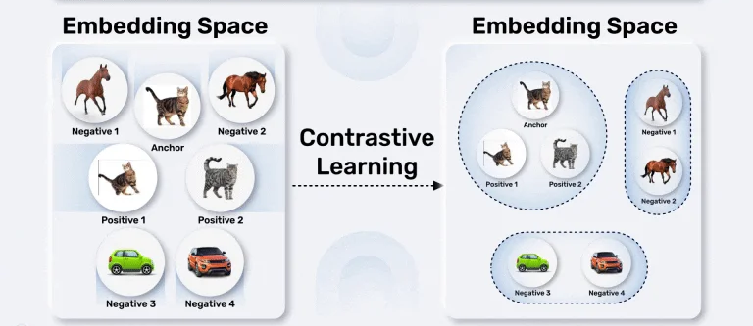
Contrast Learning
Contrast Learning, also known as Contrastive Learning, is a self-supervised learning technique that learns data representations by contrasting between similar and dissimilar samples.
The core idea is to bring similar (positive) samples closer together in the feature space while pushing dissimilar (negative) samples apart.
Image: https://learnopencv.com/

Slide 11
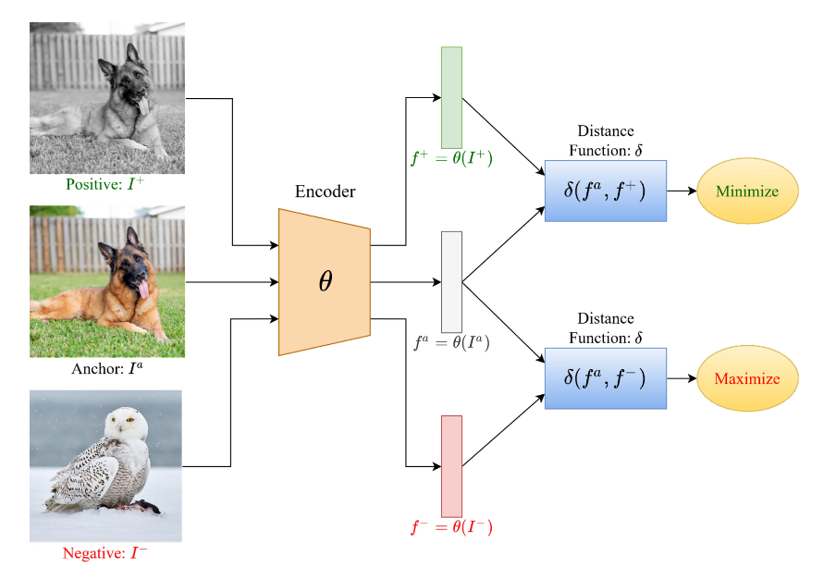
How Contrast Learning Works?
Image: https://www.v7labs.com/

Slide 12
Self-Supervised Learning
Self-Supervised Learning (SSL) is a Machine Learning paradigm where a model, when fed with unstructured data as input, generates data labels automatically, which are further used in subsequent iterations as ground truths.
Supervised Learning vs Self-Supervised Learning
Supervised Learning entails training a model with data that have high-quality manual labels associated with them to tune the model weights accordingly.
Self-Supervised Learning also entails training a model with data and their labels, but the labels here are generated by the model itself and are not available at the very start.

Slide 13
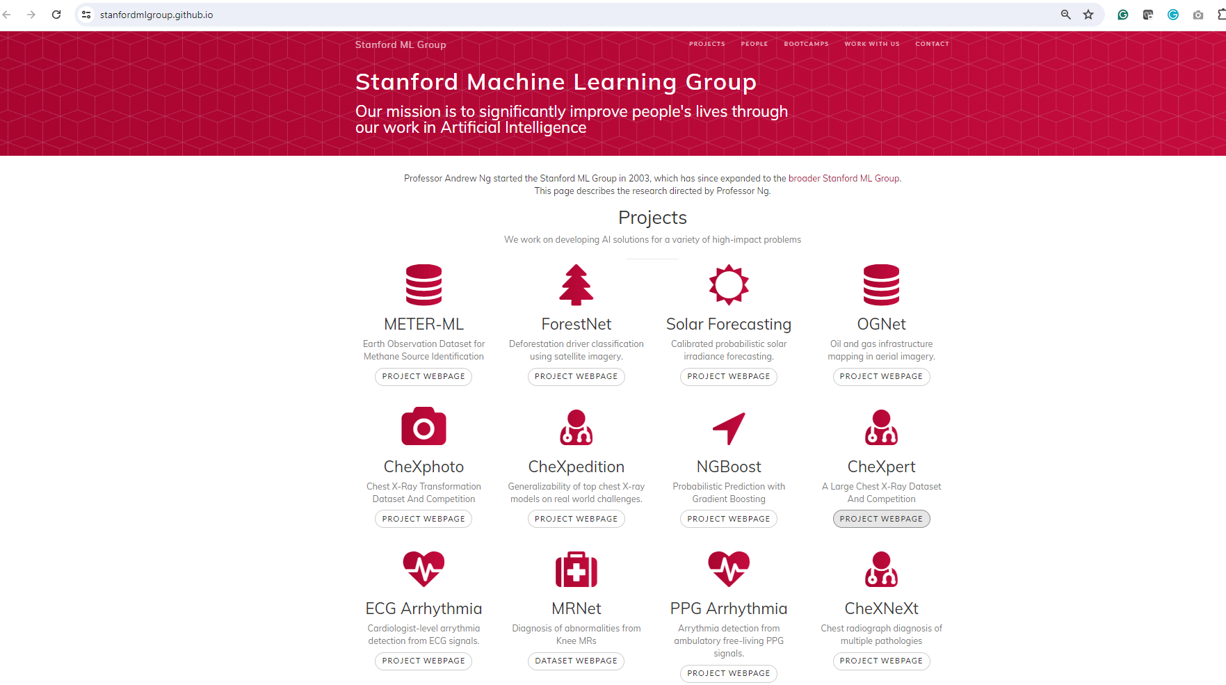
Dataset

Slide 14
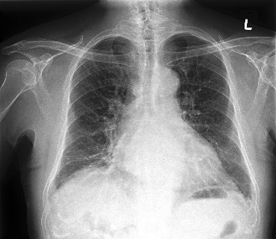
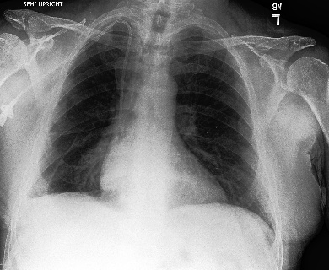
Dataset Description
Dataset Name: CheXpert
Released by: Stanford University (Irvin et al., 2019)
Collection Period: October 2002 - July 2017
Collection Location: Stanford Hospital
Dataset Size:
Total Images: 224,316 chest X-rays
Number of Patients: 65,240
Training Set: 223,414 images from 64,740 patients
Validation Set: 234 images from 200 patients
Test Set: 668 images from 500 patients (ground truth not publicly available)
Image Characteristics:
Type: Frontal and Lateral chest radiographs
Format: DICOM images converted to PNG
Resolution: Variable (upscaled/downscaled to 320×320)
Color Space: Grayscale (8-bit)

Slide 15
Why CheXpert not Other Dataset?
Provides more comprehensive representation of pathological variations.
Implements a unique three-class labeling system (positive, negative, uncertain) that better reflects the reality of clinical diagnosis.
Dataset label quality surpasses previous benchmarks through its rule-based labeler.
Expert-verified validation set ensures higher quality ground truth for model evaluation.
Standardized preprocessing pipeline ensures consistent image quality across the dataset.
Well-defined evaluation framework, focusing on five key pathologies (Atelectasis, Cardiomegaly, Consolidation, Edema, and Pleural Effusion), enables more meaningful model comparisons and benchmarking.
Clinical relevance is enhanced by its derivation from actual hospital radiographic studies and reports.

Slide 16
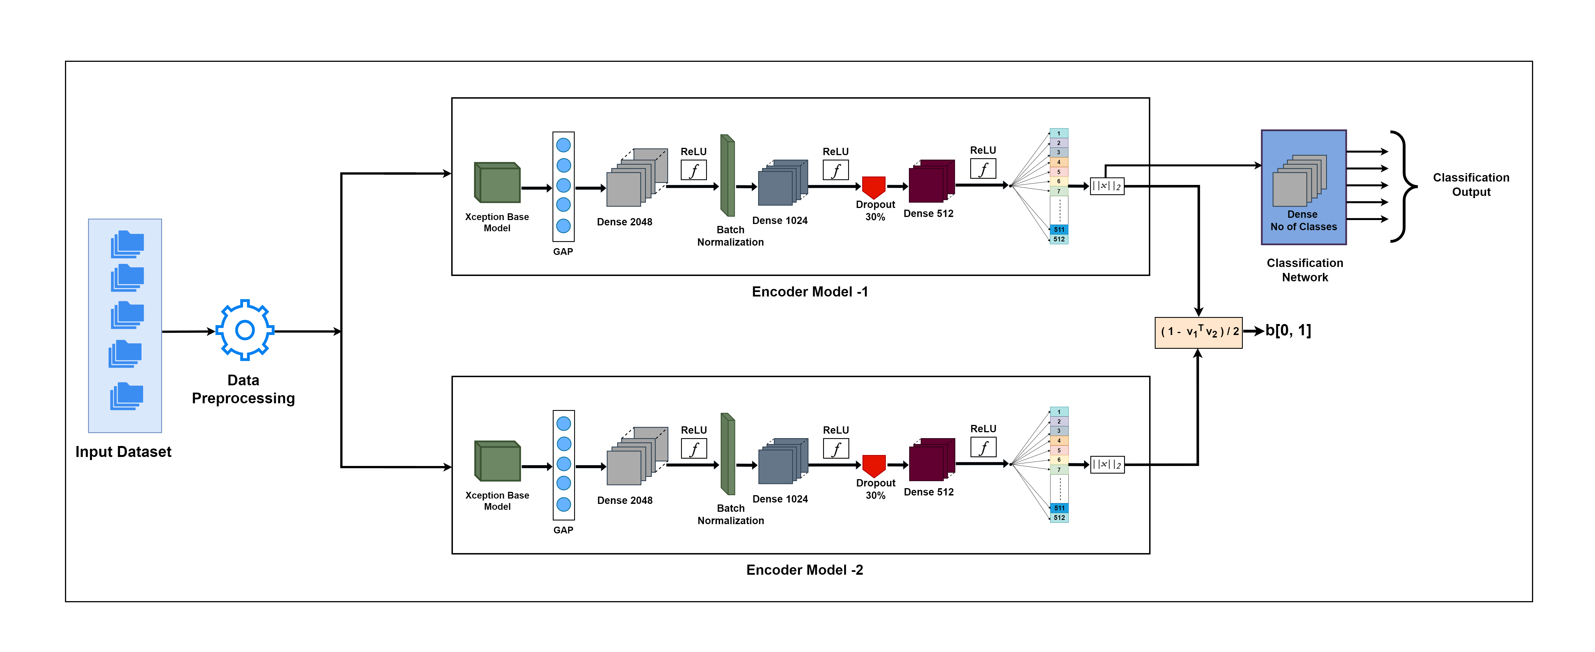
Proposed Architecture
Notes:
Advantages of GAP:
Global Average Pooling (GAP) offers several significant advantages in deep neural network architectures:
Parameter Reduction:
Significantly reduces the number of parameters compared to fully connected layers
A traditional FC layer after a convolutional layer (14x14x512) would need 14x14x512x1000=100M parameters
GAP only needs 512x1000=512K parameters, reducing overfitting risk
Spatial Information Integration:
Takes average of each feature map
Enforces correspondences between feature maps and categories
More native to convolution structure by enforcing spatial translation invariance
Regularization Effect:
Acts as a structural regularizer
Prevents overfitting by reducing model complexity
More robust to spatial translations of input
Architectural Benefits:
No need for parameter tuning in this layer
Can accept input of any size
Easier network architecture design
Visualization Enhancement:
Produces Class Activation Maps (CAM)
Better interpretability of network decisions
Enables visualization of which regions network focuses on
Feature Maps to Confidence:
Each feature map becomes responsible for a specific category
Provides direct mapping between features and categories
More interpretable network behavior
What is Batch Normalization?
back to batch normalization is a process that makes neural networks faster and more stable by adding extra layers to a deep neural network. The new layer performs the standardizing and normalizing operations on the input of a layer coming from a previous layer.
But what is the reason behind the term “Batch” in batch normalization? A typical neural network is trained using a collected input data set called batch. Similarly, the normalizing process takes place in batches, not as a single input.
Activation at Classification: Softmax
Softmax is generally considered better than sigmoid when dealing with multi-class classification problems because it outputs a probability distribution across all classes, ensuring that the probabilities for all possible classes sum to 1

Slide 17
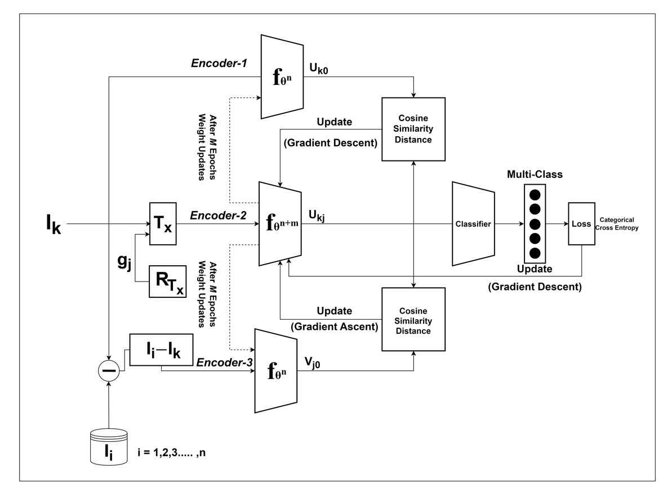
Proposed Training Scheme

Slide 18
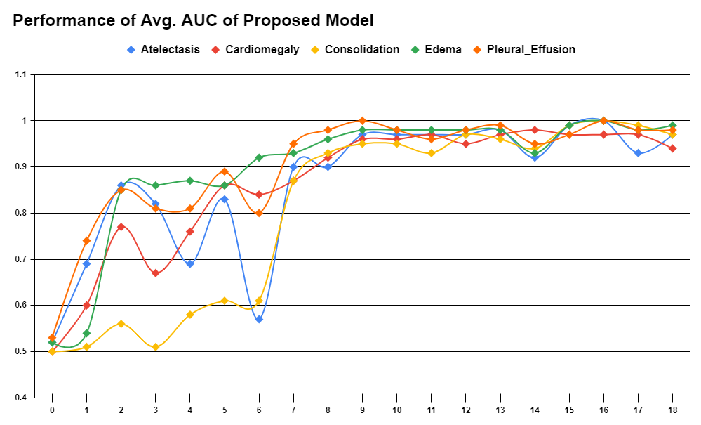
Performance of Avg AUC of Proposed Model
Value of AUC
No of Epochs

Slide 19
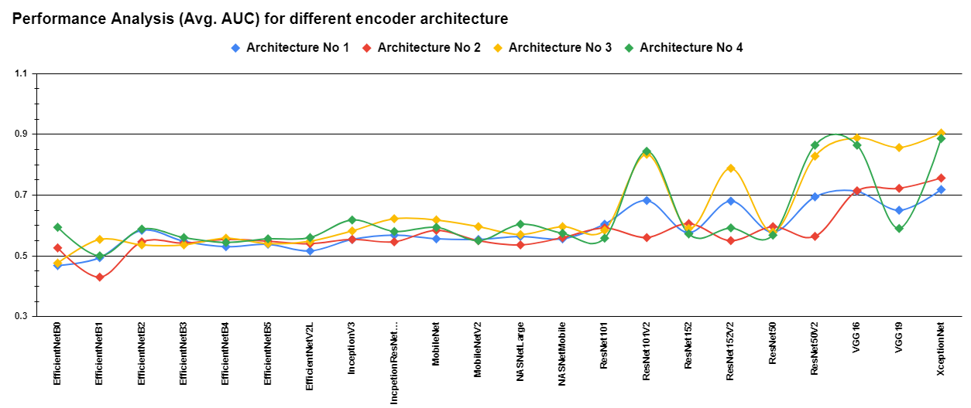
Performance Analysis (Avg. AUC) for Different Encoder Architecture
Performance
Base Model Names

Slide 20
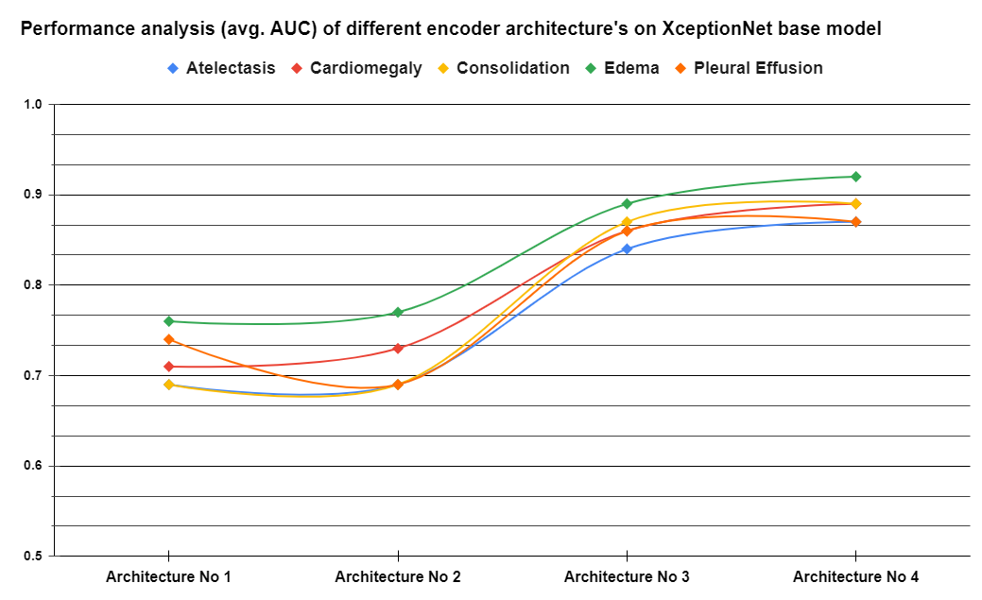
Performance Analysis (Avg. AUC) for Different Encoder Architecture on XceptionNet
Performance
Architecture Names

Slide 21
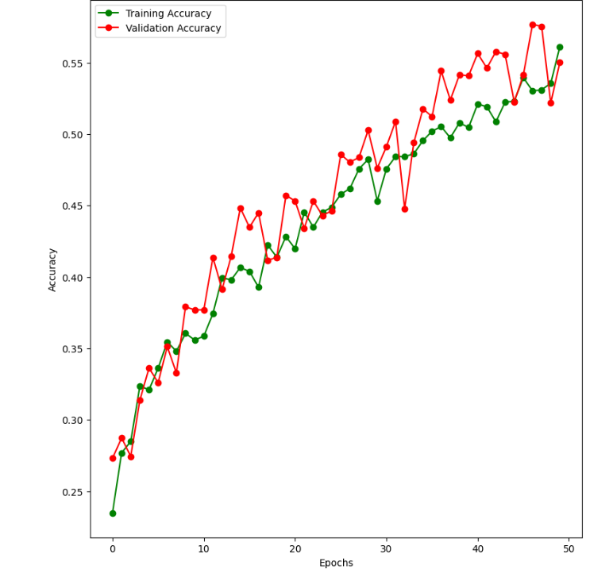
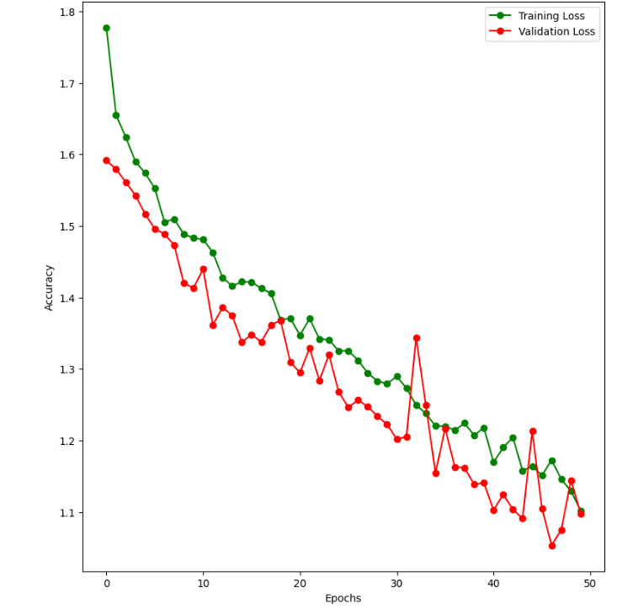
Training & Validation Analysis

Slide 22
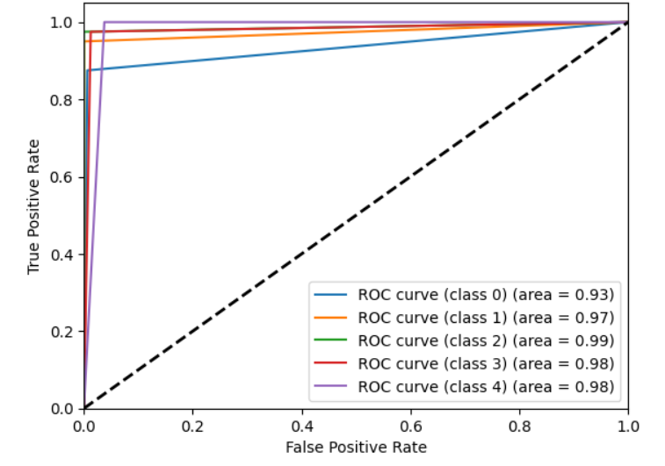
SemSSXL: Semi Self-Supervised Xception Learner

Slide 23
Problem Statement-2
Designing a deep-learning based architecture to optimize features from the input image to enhance the classification
Research Questions
How the feature abstract affect classification performance?
What is the optimal way to fuse features from transfer learning and encoder streams?
How does the dual-stream architecture compare with single-stream approaches in terms of:
Classification accuracy
Feature representation quality
Model robustness

Slide 24
Primary Objective:
Develop a novel dual-stream architecture combining feature optimization mechanisms with transfer learning.
Design an effective feature fusion strategy for various base models such as VGG, Xception, etc. and autoencoder streams.
Improve classification accuracy while maintaining model interpretability.
Evaluate the contribution of each architectural component.
Compare performance with state-of-art architectures.
Assess model generalization across different datasets.
Secondary Objective:

Slide 25
Problem Statement-3
Blockchain-Secured Federated Learning for Privacy-Preserving Multi-label Chest Disease Classification
Research Questions
How to ensure secure model aggregation across institutions?
What consensus mechanisms are most suitable for medical imaging?
How to validate model updates without compromising privacy?
How to handle data heterogeneity across institutions?

Slide 26
Blockchain-Federated Learning Pipeline:
Smart Contract Execution
Model Aggregation
Global Update
Local training
Update Generation
Blockchain Verification
Local Model Update
Notes:
Smart Contract:
A smart contract in blockchain is a self-executing program stored on the blockchain that automatically executes predefined terms and conditions. Let me explain its key aspects and functionality:
Definition and Core Concept: Smart contracts are digital contracts where the terms of the agreement are directly written into code. They automatically execute when predetermined conditions are met, eliminating the need for intermediaries.
Key Characteristics:
Self-executing and autonomous
Immutable once deployed
Transparent and verifiable
Decentralized execution
Deterministic outcomes

Slide 27
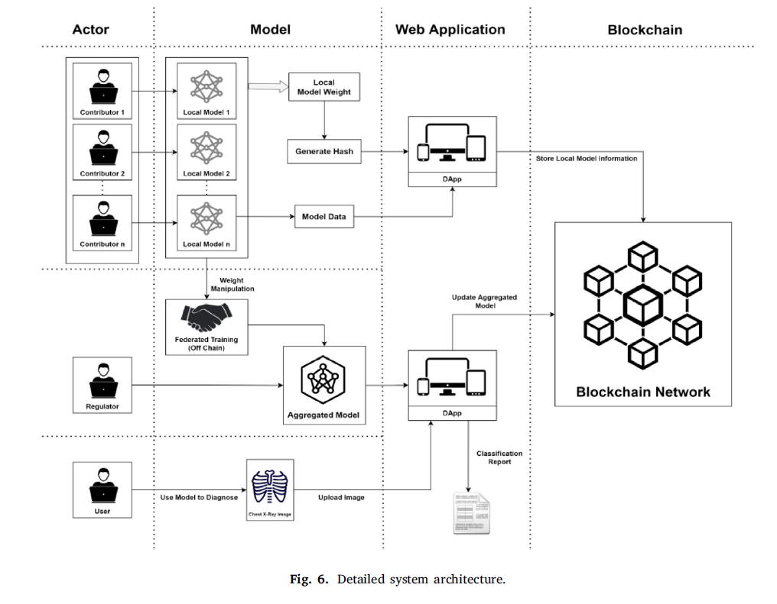
System Architecture
Ref [49]- Blockchain for medical collaboration: A federated learning-based approach for multi-class respiratory disease classification
Notes:
Why Etherium?
Community and Resources:
Largest and most active developer community
Extensive academic research papers and citations
Regular conferences and research presentations
Open-source code availability for reference
Active GitHub repositories and documentation
Technical Advantages:
Turing-complete smart contract platform
EVM (Ethereum Virtual Machine) specifications are well-defined
Multiple consensus mechanism options (PoW, PoS)
Layer 2 scaling solutions for research
Rich ecosystem of tools and frameworks
Research Areas Support:
Smart contract security research
Consensus mechanism studies
Scalability solutions
Token economics
DeFi protocols
Cross-chain interoperability
Gas optimization techniques
Publication Opportunities:
High citation potential due to platform popularity
Many IEEE and ACM publications focus on Ethereum
Regular blockchain conferences feature Ethereum research
Journal special issues on Ethereum developments
Industry recognition of research contributions
Verification and Validation:
Easy deployment to test networks
Transaction tracing and debugging tools
Gas analysis capabilities
Security analysis tools integration
Automated testing frameworks
This combination of features makes Ethereum particularly suitable for academic research, especially in areas requiring smart contract implementation, security analysis, or protocol development.
CopyRetry

Slide 28
Implementation Framework
Training Protocol
Local Training Phase | Blockchain Verification | Global Aggregation
Data preparation Model initialization Local optimization Update generation | Update Submission Smart contract execution Consensus achievement Reward distribution | Update collection Weighted averaging Model verification Distribution
Privacy Preservation
Data Privacy | Model Privacy
Local data retention Anonymization Encryption | Parameter Encryption Secure Aggregation Split learning

Slide 29
Evaluation Framework
Performance Metrics
Model Performance | System Metrics | Privacy Metrics
Classification Accuracy AUC-ROC Curve | Communication overhead Computational cost Storage requirements | Information leakage Attack resistance Compliance score

Slide 30
Expected Outcomes
Technical Achievements
Clinical Impact
Secure Framework | Performance Gains
Privacy preservation Model integrity Audit capability Compliance assurance | Improved accuracy Faster convergence Better generalization Reduced costs
Collaboration Benefits | Implementation Benefits
Knowledge sharing Resource Optimization Larger Datasets Better Models | Privacy Compliance Trust Enhancement Cost Reduction Scalability

Slide 31
References
[1] J. Irvin, P. Rajpurkar, M. Ko, Y. Yu, S. Ciurea-Ilcus, V. Neculae, S. Mehta, T. Duan, D. Ding, A. Bagul, et al., Chexpert: A large chest radiograph dataset with uncertainty labels and expert comparison, in: Proceedings of the AAAI conference on artificial intelligence, Vol. 33, 2019, pp. 590–597.
[2] J. Bromley, J. W. Bentz, L. Bottou, I. Guyon, Y. LeCun, C. Moore, E. S¨ackinger, R. Shah, Signature verification using a” siamese” time delay neural network, in: Advances in neural information processing systems, 1994.
[3] F. Chollet, Xception: Deep learning with depthwise separable convolutions, in: Proceedings of the IEEE conference on computer vision and pattern recognition, 2017, pp. 1251–1258.
[4] A. Jaiswal, A. R. Babu, M. Z. Zadeh, D. Banerjee, F. Makedon, A survey on contrastive self-supervised learning, ArXiv abs/2011.00362 (2020).
[5] D. Kermany, M. Goldbaum, W. Cai, C. Valentim, H.-Y. Liang, S. Baxter, A. McKeown, G. Yang, X. Wu, F. Yan, J. Dong, M. Prasadha, J. Pei, M. Ting, J. Zhu, C. Li, S. Willens, J. Dong, I. Ziyar, K. Zhang, Identifying medical diagnoses and treatable diseases by image-based deep learning, Cell 172 (2018) 1122–1131.e9.
[6] M. Anthimopoulos, S. Christodoulidis, L. Ebner, A. Christe, S. Mougiakakou, Lung pattern classification for interstitial lung diseases using a deep convolutional neural network, IEEE Transactions on Medical Imaging 35 (2016) 1–1.
[7] P. Rajpurkar, Chexnet: Radiologist-level pneumonia detection on chest x-rays with deep learning, ArXiv abs/1711 5225 (2017).

Slide 32
References
[8] P. Lakhani, B. Sundaram, Deep learning at chest radiography: automated classification of pulmonary tuberculosis by using convolutional neural networks, Radiology 284 (2) (2017) 574–582.
[9] P. Rajpurkar, J. Irvin, R. L. Ball, K. Zhu, B. Yang, H. Mehta, T. Duan, D. Ding, A. Bagul, C. P. Langlotz, et al., Deep learning for chest radiograph diagnosis: A retrospective comparison of the chexnext algorithm to practicing radiologists, PLOS medicine 15 (11) (2018) e1002686.
[10] A. P. Brady, Error and discrepancy in radiology: inevitable or avoidable?, Insights into imaging 8 (1) (2017) 171–182.
[11] W. H. Organization, Global health workforce statistics database (2023).
[12] E. A. Krupinski, K. J. Dreyer, C. P. Langlotz, The impact of artificial intelligence on radiology workforce: Global perspectives and emerging trends,European radiology 32 (9) (2022) 6012–6021.
[13] A. Hosny, P. Bhatnagar, Global radiological services access and quality index: A cross-sectional analysis, The Lancet Digital Health 5 (4) (2023) e235–e244.
[14] L. Zhang, et al., Advancing medical image analysis through self-supervised learning: A comprehensive review, Medical Image Analysis 89 (2023) 102862.

Slide 33
References
[15] T. Chen, S. Kornblith, M. Norouzi, G. Hinton, A simple framework for contrastive learning of visual representations, in: International conference on machine learning, PMLR, 2020, pp. 1597–1607.
[16] E. C¸ allı, E. Sogancioglu, B. van Ginneken, K. G. van Leeuwen, K. Murphy, Deep learning for chest x-ray analysis: A survey, Medical Image Analysis 72 (2021) 102125.
[17] G. Litjens, T. Kooi, B. E. Bejnordi, A. A. A. Setio, F. Ciompi, M. Ghafoorian, J. A. van der Laak, B. van Ginneken, C. I. S´anchez, A survey on
deep learning in medical image analysis, Medical image analysis 42 (2017) 60–88.
[18] G. I. Okolo, S. Katsigiannis, N. Ramzan, Ievit: An enhanced vision transformer architecture for chest x-ray image classification, Computer Methods and Programs in Biomedicine 226 (2022) 107141. doi:https://doi.org/10.1016/j.cmpb.2022.107141.URL https://www.sciencedirect.com/science/article/pii/
[19] S. Chopra, R. Hadsell, Y. LeCun, Learning a similarity metric discriminatively, with application to face verification, in: 2005 IEEE computer society conference on computer vision and pattern recognition (CVPR’05), Vol. 1, IEEE, 2005, pp. 539–546.
[20] C. Doersch, A. Gupta, A. A. Efros, Unsupervised visual representation learning by context prediction, in: Proceedings of the IEEE international conference on computer vision, 2015, pp. 1422–1430.
[21] S. Gidaris, P. Singh, N. Komodakis, Unsupervised representation learning by predicting image rotations, arXiv preprint arXiv:1803.07728 (2018).

Slide 34
References
[22] M. Noroozi, P. Favaro, Unsupervised learning of visual representations by solving jigsaw puzzles, in: European conference on computer vision, Springer, 2016, pp. 69–84.
[23] R. Zhang, P. Isola, A. A. Efros, Colorful image colorization, in: Computer Vision–ECCV 2016: 14th European Conference, Amsterdam, The Netherlands, October 11-14, 2016, Proceedings, Part III 14, Springer, 2016, pp. 649–666.
[24] S. Azizi, B. Mustafa, F. Ryan, Z. Beaver, J. Freyberg, J. Deaton, A. Loh, A. Karthikesalingam, S. Kornblith, T. Chen, et al., Big self-supervised models advance medical image classification, in: Proceedings of the IEEE/CVF international conference on computer vision, 2021, pp. 3478–3488.
[25] Z. Wu, Y. Xiong, S. X. Yu, D. Lin, Unsupervised feature learning via non-parametric instance discrimination, in: Proceedings of the IEEE conference on computer vision and pattern recognition, 2018, pp. 3733–3742.
[26] O. Henaff, Data-efficient image recognition with contrastive predictive coding, in: International conference on machine learning, PMLR, 2020, pp. 4182–4192.
[27] A. v. d. Oord, Y. Li, O. Vinyals, Representation learning with contrastive predictive coding, arXiv preprint arXiv:1807.03748 (2018).
[28] R. D. Hjelm, A. Fedorov, S. Lavoie-Marchildon, K. Grewal, P. Bachman, A. Trischler, Y. Bengio, Learning deep representations by mutual information estimation and maximization, arXiv preprint arXiv:1808.06670 (2018).

Slide 35
References
[29] M. Ye, X. Zhang, P. C. Yuen, S.-F. Chang, Unsupervised embedding learning via invariant and spreading instance feature, in: Proceedings of the IEEE/CVF conference on computer vision and pattern recognition, 2019, pp. 6210–6219.
[30] P. Bachman, R. D. Hjelm, W. Buchwalter, Learning representations by maximizing mutual information across views, Advances in neural information processing systems 32 (2019).
[31] Y. Tian, D. Krishnan, P. Isola, Contrastive multiview coding, in: Computer Vision–ECCV 2020: 16th European Conference, Glasgow, UK, August 23–28, 2020, Proceedings, Part XI 16, Springer, 2020, pp. 776–794.
[32] X. Chen, H. Fan, R. Girshick, K. He, Improved baselines with momentum contrastive learning, arXiv preprint arXiv:2003.04297 (2020).
[33] K. He, H. Fan, Y.Wu, S. Xie, R. Girshick, Momentum contrast for unsupervised visual representation learning, IEEE/CVF Conference on Computer Vision and Pattern Recognition (2020) 9729–9738.
[34] I. Misra, L. v. d. Maaten, Self-supervised learning of pretext-invariant representations, in: Proceedings of the IEEE/CVF conference on computer vision and pattern recognition, 2020, pp. 6707–6717.
[35] T. Chen, S. Kornblith, K. Swersky, M. Norouzi, G. Hinton, Big self supervised models are strong semi-supervised learners, arXiv preprint arXiv:2006.10029 (2020).

Slide 36
References
[29] M. Ye, X. Zhang, P. C. Yuen, S.-F. Chang, Unsupervised embedding learning via invariant and spreading instance feature, in: Proceedings of the IEEE/CVF conference on computer vision and pattern recognition, 2019, pp. 6210–6219.
[30] P. Bachman, R. D. Hjelm, W. Buchwalter, Learning representations by maximizing mutual information across views, Advances in neural information processing systems 32 (2019).
[31] Y. Tian, D. Krishnan, P. Isola, Contrastive multiview coding, in: Computer Vision–ECCV 2020: 16th European Conference, Glasgow, UK, August 23–28, 2020, Proceedings, Part XI 16, Springer, 2020, pp. 776–794.
[32] X. Chen, H. Fan, R. Girshick, K. He, Improved baselines with momentum contrastive learning, arXiv preprint arXiv:2003.04297 (2020).
[33] K. He, H. Fan, Y.Wu, S. Xie, R. Girshick, Momentum contrast for unsupervised visual representation learning, IEEE/CVF Conference on Computer Vision and Pattern Recognition (2020) 9729–9738.
[34] I. Misra, L. v. d. Maaten, Self-supervised learning of pretext-invariant representations, in: Proceedings of the IEEE/CVF conference on computer vision and pattern recognition, 2020, pp. 6707–6717.
[35] T. Chen, S. Kornblith, K. Swersky, M. Norouzi, G. Hinton, Big selfsupervised models are strong semi-supervised learners, arXiv preprint arXiv:2006.10029 (2020).

Slide 37
References
[36] J.-B. Grill, F. Strub, F. Altch´e, C. Tallec, P. Richemond, E. Buchatskaya, C. Doersch, B. Avila Pires, Z. Guo, M. Gheshlaghi Azar, et al., Bootstrap your own latent-a new approach to self-supervised learning, Advances in neural information processing systems 33 (2020) 21271–21284.
[37] S. J. Pan, Q. Yang, A survey on transfer learning, IEEE Transactions on knowledge and data engineering 22 (10) (2009) 1345–1359.
[38] A. Davila, J. Colan, Y. Hasegawa, Comparison of fine-tuning strategies for transfer learning in medical image classification, Image and Vision Computing 146 (2024) 105012.
[39] P. Moeskops, J. M. Wolterink, B. H. Van Der Velden, K. G. Gilhuijs, T. Leiner, M. A. Viergever, I. Iˇsgum, Deep learning for multi-task medical image segmentation in multiple modalities, in: Medical Image Computing and Computer-Assisted Intervention–MICCAI 2016: 19th International Conference, Athens, Greece, October 17-21, 2016, Proceedings, Part II 19, Springer, 2016, pp. 478–486.
[40] U. Kamal, M. Zunaed, N. B. Nizam, T. Hasan, Anatomy-xnet: An anatomy aware convolutional neural network for thoracic disease classification in chest x-rays, IEEE Journal of Biomedical and Health Informatics 26 (11) (2022) 5518–5528.
[41] M. Caron, I. Misra, J. Mairal, P. Goyal, P. Bojanowski, A. Joulin, Unsupervised learning of visual features by contrasting cluster assignments, in: Advances in Neural Information Processing Systems, Vol. 33, 2020, pp. 9912–9924.
[42] Z. Y. Diong, W. Y. Lim, C. P. Goh, Self-supervised learning in medical diagnostics: An examination of simclr and byol in image classification, in: 2024 3rd International Conference on Digital Transformation and Applications (ICDXA), IEEE, 2024, pp. 210–214.

Slide 38
References
[43] T. Dai, R. Zhang, F. Hong, J. Yao, Y. Zhang, Y.Wang, Unichest: Conquerand-divide pre-training for multi-source chest x-ray classification, IEEE Transactions on Medical Imaging (2024).
[44] E. Tiu, E. Talius, P. Patel, C. P. Langlotz, A. Y. Ng, P. Rajpurkar, Expertlevel detection of pathologies from unannotated chest x-ray images via selfsupervised learning, Nature Biomedical Engineering 6 (12) (2022) 1399– 1406.
[45] H. Sowrirajan, J. Yang, A. Y. Ng, P. Rajpurkar, Moco pretraining improves representation and transferability of chest x-ray models, Medical Image Analysis 71 (2021) 102051.
[46] H. H. Pham, T. T. Le, D. Q. Tran, D. T. Ngo, H. Q. Nguyen, Interpreting chest x-rays via cnns that exploit hierarchical disease dependencies and uncertainty labels, Neurocomputing 437 (2021) 186–194.
[47] C. Mao, L. Yao, Y. Luo, Imagegcn: Multi-relational image graph convolutional networks for disease identification with chest x-rays, IEEE transactions on medical imaging 41 (8) (2022) 1990–2003.
[48] I. Allaouzi, M. B. Ahmed, A novel approach for multi-label chest x-ray classification of common thorax diseases, IEEE Access 7 (2019) 64279– 64288.
[49] Noman, A.A., Rahaman, M., Pranto, T.H. and Rahman, R.M., 2023. Blockchain for medical collaboration: A federated learning-based approach for multi-class respiratory disease classification. Healthcare Analytics, 3, p.100135.

Slide 39
Thank You!
Photo by Pexels

